Slide 1

COS3023/N
Operating Systems and Concurrency
Topic 2- PROCESS MANAGEMENT (Part 3)
THREADS & Inter process communication (IPC)
Lecturer : Ms. Shafrah

Slide 2
Learning objectives
To explain about thread in process.
To understand the concept of IPC.

Slide 3
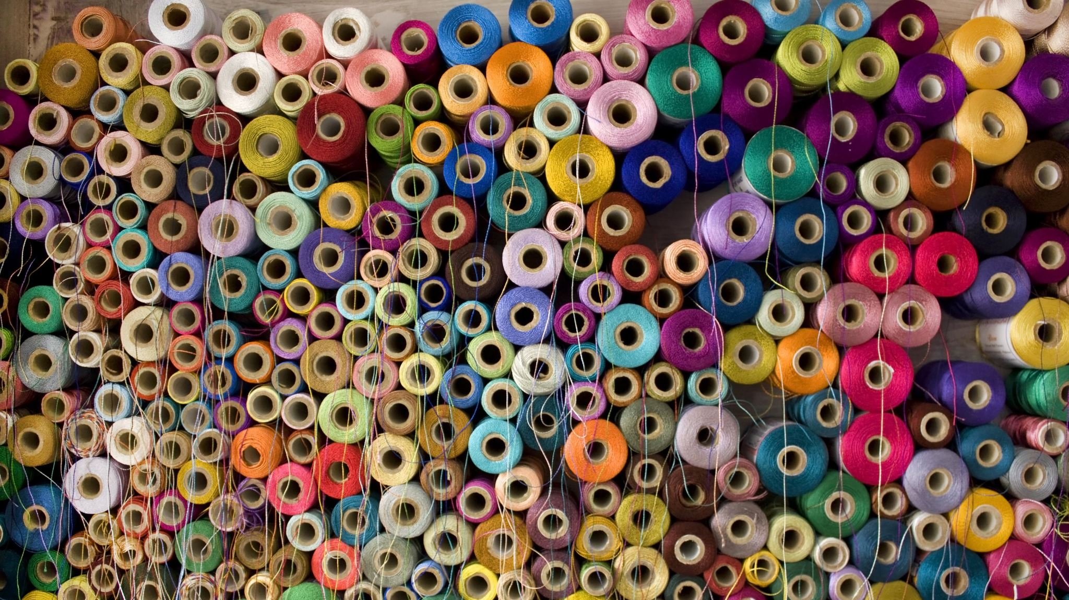
THREAD

Slide 4
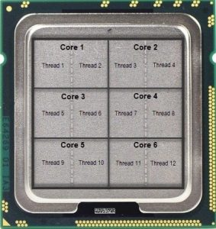
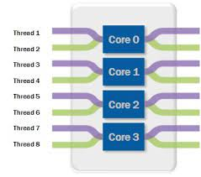
Threads

Slide 5
WHAT ARE THREADS?
A thread is a basic unit of CPU utilization; ID PC RG STK
it comprises a thread ID, a program counter (PC), a register set, and a stack.
It shares with other threads belonging to the same process its code section, data section, and other operating-system resources, such as open files and signals.
A traditional process has a single thread of control.
If a process has multiple threads of control, it can perform more than one task at a time.

Slide 6
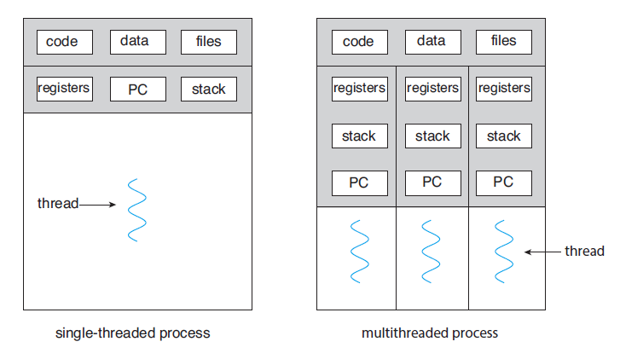
Single and Multithread Processes

Slide 7
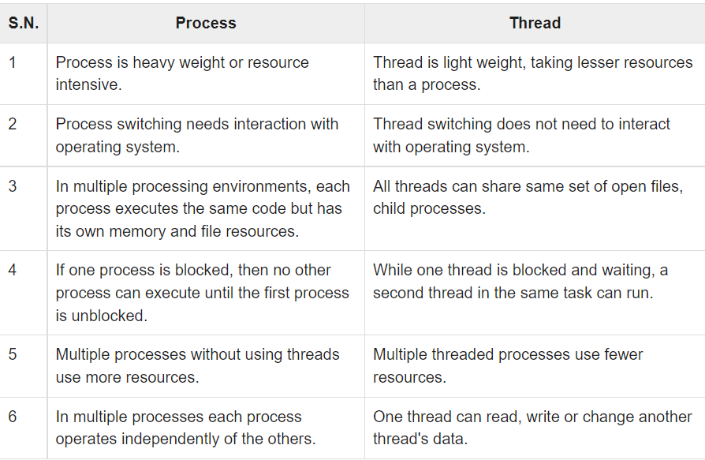




















Differences between process & thread
Resource usage
Switching
Interaction with OS
Resource sharing
Parallel execution
Resources amount
Interaction with peer

Slide 8
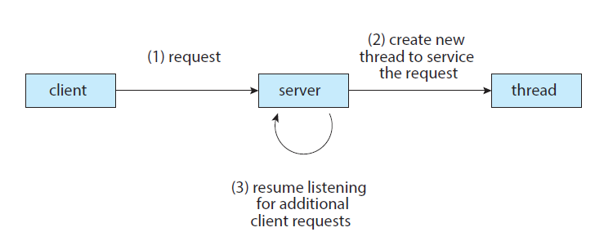
Multithreaded server architecture

Slide 9
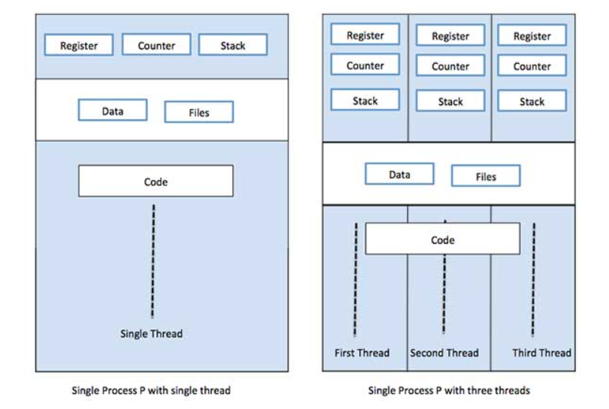
Conclusion

Slide 10
Benefits of multithreaded programming
RREE
Responsiveness - One thread may provide rapid response while other threads are blocked or slowed down doing intensive calculations.
Resource sharing - By default threads share common code, data, and other resources, which allows multiple tasks to be performed simultaneously in a single address space.
Economy - Creating and managing threads ( and context switches between them ) is much faster than performing the same tasks for processes. Uses less resources and reduce overhead costs
Efficiency, i.e. Utilization of multiprocessor architectures - A single threaded process can only run on one CPU, no matter how many may be available, whereas the execution of a multi-threaded application may be split amongst available processors.

Slide 11
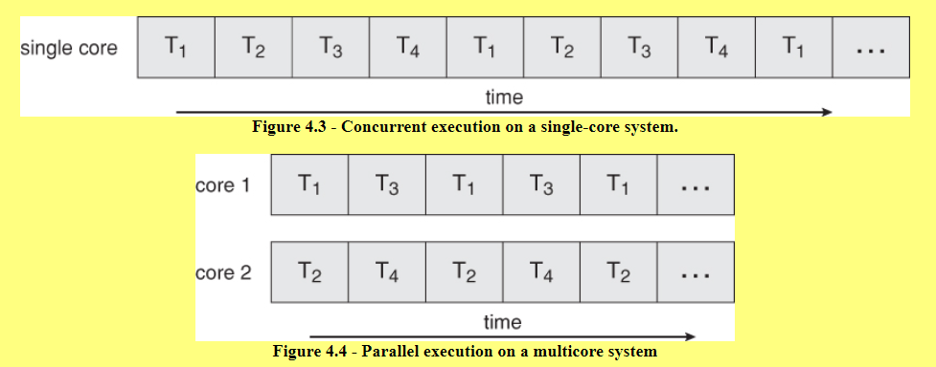
Multicore programming

Slide 12
Types of Parallelism
Data parallelism divides the data up amongst multiple cores ( threads ) and performs the same task on each subset of the data.
Task parallelism divides the different tasks to be performed among the different cores and performs them simultaneously.

Slide 13
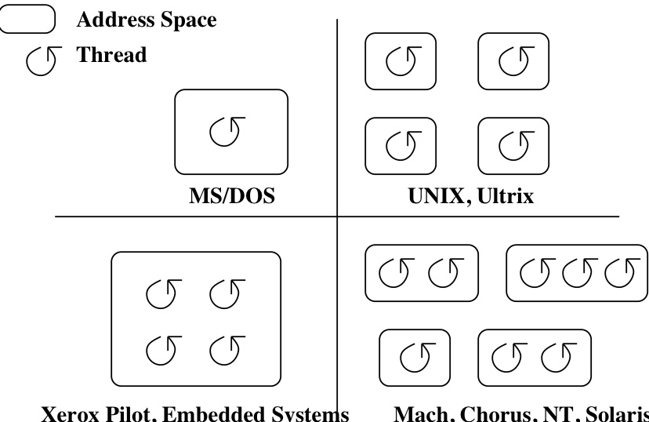

Classifying Threaded Systems
Operating Systems can support one or many address spaces, and one or many threads per address space.

Slide 14
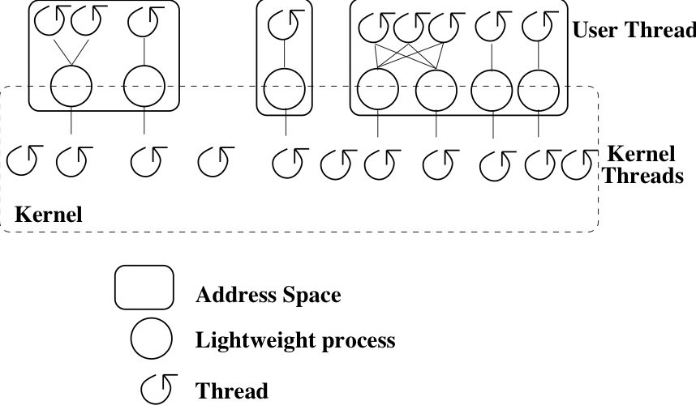
Types of Threads
Creating a thread can be a system call to the kernel, or a procedure call to a thread library (user code).
There are two types of threads; kernel threads and user level threads

Slide 15
Kernel Threads
A kernel thread, also known as a lightweight process, is a thread that the operating system knows about.
Switching between kernel threads of the same process requires a small context switch.
  The values of registers, program counter, and stack pointer must be changed.
  Memory management information does not need to be changed since the threads share an address space.
The kernel must manage and schedule threads (as well as processes), but it can use the same process scheduling algorithms.
  Switching between kernel threads is faster than switching between processes.

Slide 16
Advantages & Disadvantages of Kernel thread
Advantages
Kernel can simultaneously schedule multiple threads from the same process on multiple processors.
If one thread in a process is blocked, the Kernel can schedule another thread of the same process.
Kernel routines themselves can be multithreaded.
Disadvantages
Kernel threads are generally slower to create and manage than the user threads.
Transfer of control from one thread to another within the same process requires a mode switch to the Kernel.

Slide 17
User-Level Threads
A user-level thread is a thread that the OS does not know about.
The OS only knows about the process containing the threads.
The OS only schedules the process, not the threads within the process.
The programmer uses a thread library to manage threads (create and delete them, synchronize them, and schedule them).

Slide 18
User-Level Threads
User-Level Threads: Advantages
There is no context switch involved when switching threads. User-level thread scheduling is more flexible
  A user-level code can define a problem dependent thread scheduling policy.
  Each process might use a different scheduling algorithm for its own threads.
  A thread can voluntarily give up the processor by telling the scheduler it will yield to other threads.
User-level threads do not require system calls to create them or context switches to move between them

Slide 19
User-Level Threads
User-Level Threads: Disadvantages
No true parallelism
  Multiple threads in process cannot run concurrently
Since the OS does not know about the existence of the user-level threads, OS may make poor scheduling decisions:
  It might run a process that only has idle threads.
  If a user-level thread is waiting for I/O, the entire process will wait.
  Solving this problem requires communication between the kernel and the user-level thread manager.
Since the OS just knows about the process, it schedules the process the same way as other processes, regardless of the number of user threads.
For kernel threads, the more threads a process creates, the more time slices the OS will dedicate to it.

Slide 20
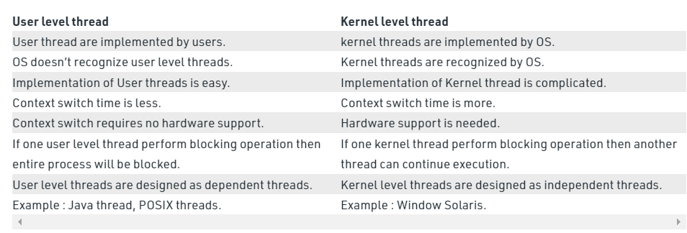
Difference between User Level thread and Kernel Level thread
Implemented by who
Is known by OS
Difficulty of implementing
Context switch time
Thread blockage handling

Slide 21
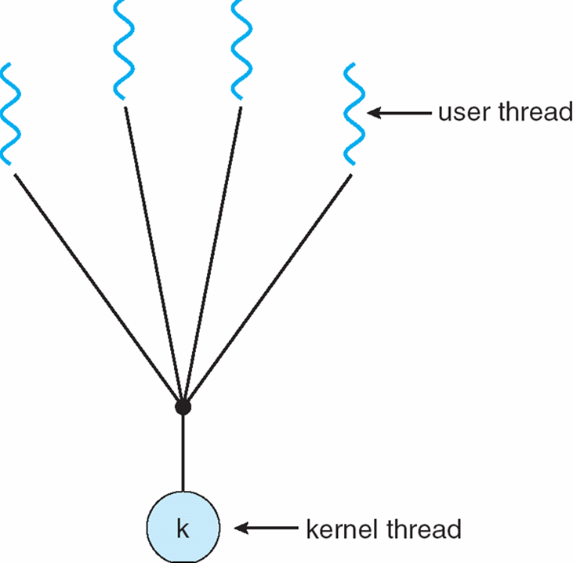
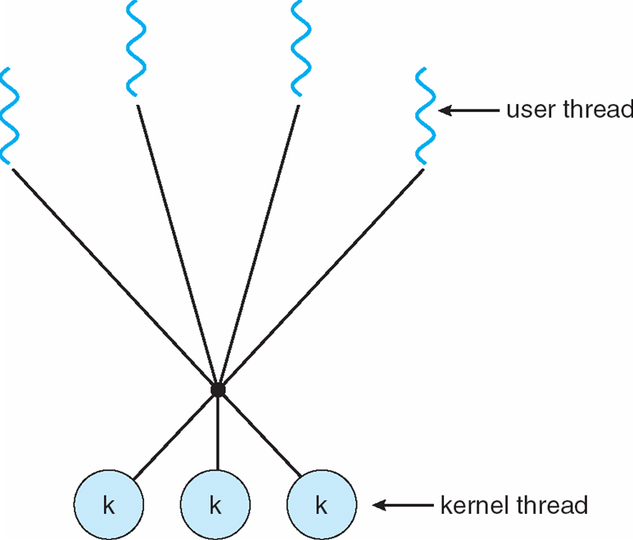
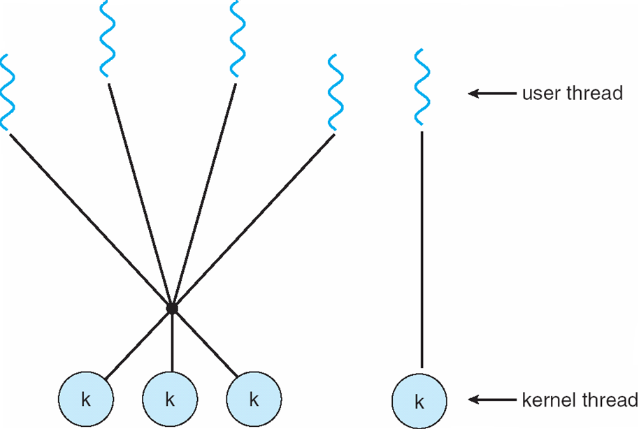
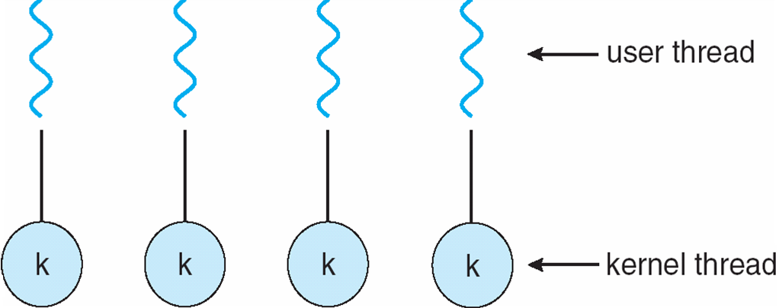
Threading Models
Many-to-one, one-to-one, many-to-many and two-level

Slide 22
Thread Libraries
Thread library provides programmer with API for creating and managing threads
Two primary ways of implementing
  Library entirely in user space
  Kernel-level library supported by the OS

Slide 23

Inter-process communication (IPC)

Slide 24



Process & IPC
A series of actions.
A process is a program under execution i.e an active program.
  Independent (not affected by execution of other process)
  Cooperative(can be affected by other executing program)
Interprocess Communication( IPC)
A mechanism which allows process to communicate with each other and synchronize their action.
Any process that shares data with other processes is a cooperating process.

Slide 25

Why we use IPC?
Information sharing
Several users interested in single piece of information. Eg: shared file.
Information can be accessed concurrently(several users can access the information at the same time)
Resource sharing
Allow to share resources.
Computation speed up
Divide a task(process) into several sub tasks. These sub tasks will make to run concurrently. So, can speed up the system. These sub tasks need to cooperate with each others.

Slide 26
Why we use IPC?
Synchronization
Synchronize data
Modularity
Design a system by dividing into several modules. These modules need to communicate/cooperate with other modules.
Convenience
Several different tasks at the same time. Eg listening to music, typing a document, printing a document at the same time. So , provides convenience .

Slide 27
Role of Synchronization in IPC
Mutual Exclusion:- It is generally required that only one process thread can enter the critical section at a time. This also helps in synchronization and creates a stable state to avoid the race condition.
Semaphore:- Semaphore is a type of variable that usually controls the access to the shared resources by several processes.
Barrier:- A barrier typically not allows an individual process to proceed unless all the processes does not reach it. It is used by many parallel languages, and collective routines impose barriers.
Spinlock:- Spinlock is a type of lock as its name implies. The processes are trying to acquire the spinlock waits or stays in a loop while checking that the lock is available or not. It is known as busy waiting because even though the process active, the process does not perform any functional operation (or task).

Slide 28
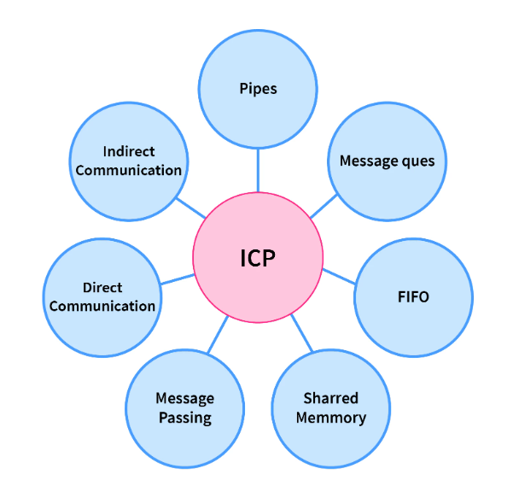
Approaches for IPC Communication
Direct communication
Indirect communication
Pipes
Message Passing
Shared memory
Message queues
FIFO

Slide 29
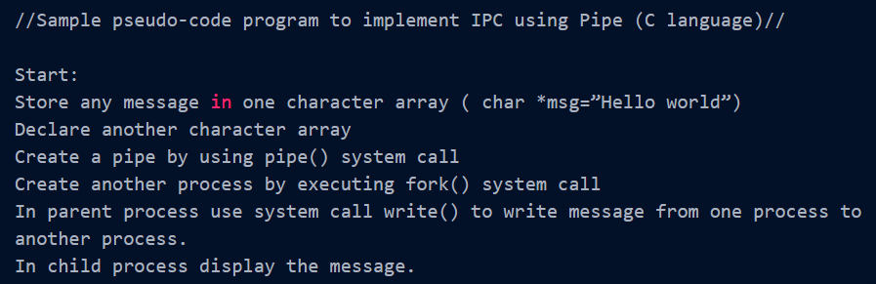
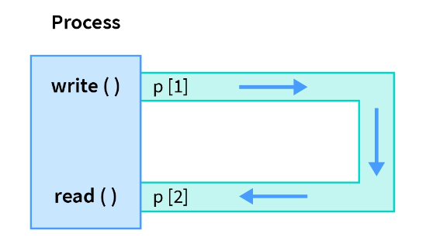
PIPES

Slide 30

IPC Mechanisms
The process can communicate with each other by using:
  1. Shared memory
  2. Message passing

Slide 31
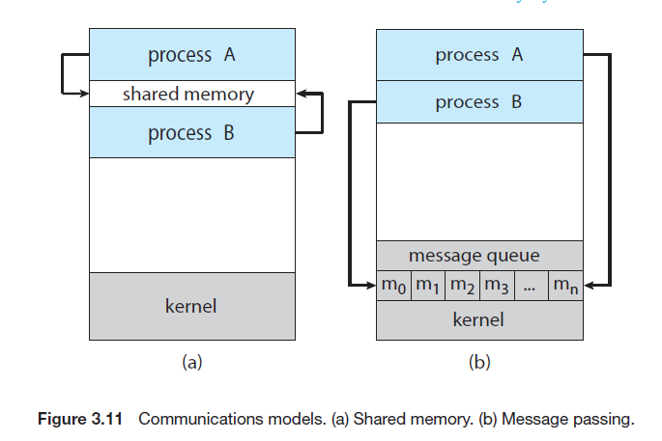

Slide 32
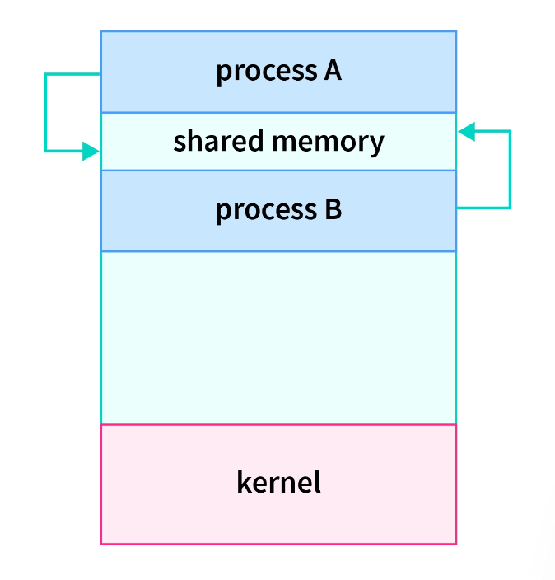
Shared Memory
In the shared-memory model, a region of memory that is shared by cooperating processes is established.
Processes can then exchange information by reading and writing data to the shared region.

Slide 33
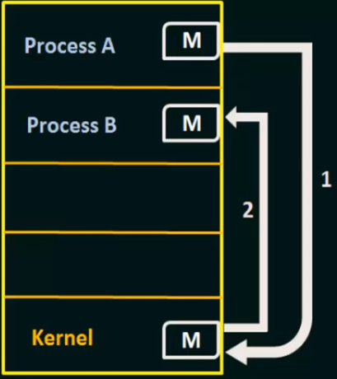
Message Passing
Process communicate with each other without using any shared memory.
Eg : Process A and Process B wants to communicate. So it has to :
Establish a communication link
Start exchange message using basic primitive
basic primitive:
* send (message to send, destination)
* Receive(message, host- where the message come in)

Slide 34
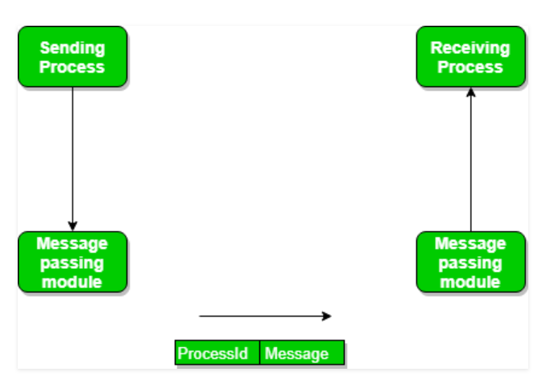
Message passing
How the message is passing?

Slide 35
Summary
What is IPC?
Why IPC?
IPC mechanism.

Slide 36
Question
1. Inter process communication :
a) allows processes to communicate and synchronize their actions when using the same address space
b) allows processes to communicate and synchronize their actions without using the same address space
c) allows the processes to only synchronize their actions without communication
d) none of the mentioned

Slide 37
Question
2. Message passing system allows processes to :
a) communicate with one another without resorting to shared data
b) communicate with one another by resorting to shared data
c) share data
d) name the recipient or sender of the message

Slide 38
Question
3. An IPC facility provides at least two operations :
a) write & delete message
b) delete & receive message
c) send & delete message
d) receive & send message

Slide 39
Question
4. The link between two processes P and Q to send and receive messages is called :
a) communication link
b) message-passing link
c) synchronization link
d) all of the mentioned

Slide 40
Question
5. Which are two fundamental models of interprocess communication:
Shared memory
Message passing
Independent
Cooperating
1.2
2,3
3,4
1,4

Slide 41
Question
6. Message passing provides a mechanism to allow processes to communicate and to synchronize their actions
By sharing the same address space
Without sharing the same address space
By sharing the same process number and process Identifier
None of the above.

Slide 42

THANK YOU

